Slide 1
Low-Power Retentive True Single-Phase-Clocked Flip-Flop With Redundant-Precharge-Free Operation
By
Yathin Kumar - IMT2020550
B Sathiya Naraayanan - IMT2020534
Maurya Patel - IMT2020517
Paras - IMT2020547

Slide 2
Agenda
Introduction
State of art designs
Proposed design
Results and Simulations

Slide 3
Introduction
Objective of Paper - To design power efficient flip-flop that can operate at low voltages
Applications - Sequential circuits which use more no.of flip- flops
Approach -
Voltage scaling
Eliminating redundant charging and discharging of internal nodes
Optimisation in circuit level

Slide 4
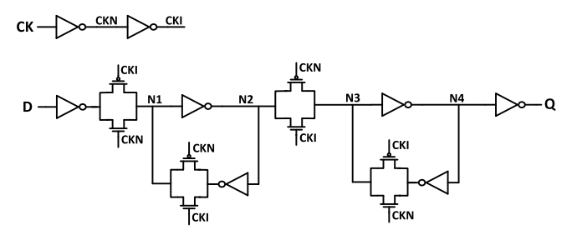
TGFF
Advantages
No contention on the output node
Drawbacks
Large clock network
Unnecessary toggling of CKN and CKI nodes even when the data activity is 0
Not single phases clock.

Slide 5
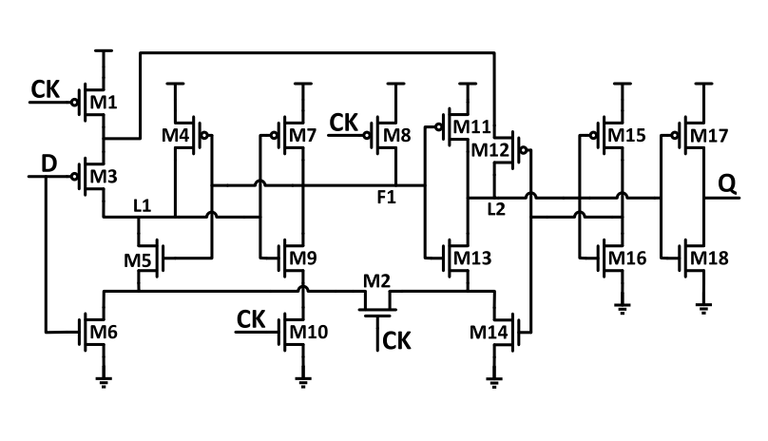
SPC-18T - Single phase clock Flip-Flop
Advantages
Simplified logic
No.of transistors connected to clk signal are less
Drawbacks
Redundant charging and discharging of node F1.
Short circuit path
D 1->0 L1 charged at neg edge of clk and discharged as shown
Increase in hold time

Slide 6
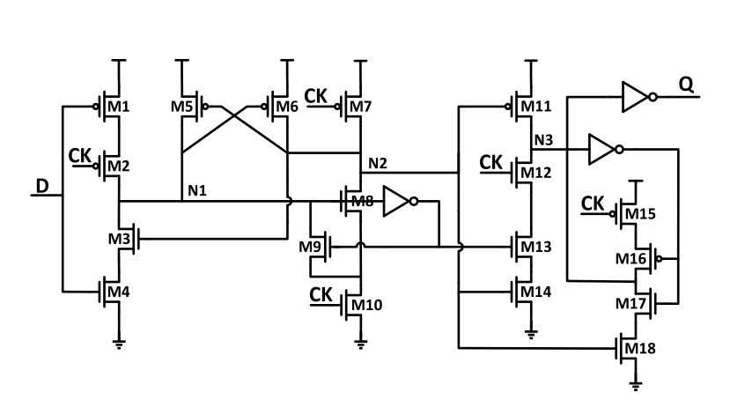
S2CFF - Static Single-phase-clocked contention-free Flip-Flop
Advantages
No current congestion at output node
Drawbacks
Unnecessary precharge and discharge -
When D=0 and neg half cycle of clk N2 is charged by M7 and discharged by M8 and M10 at rising edge

Slide 7
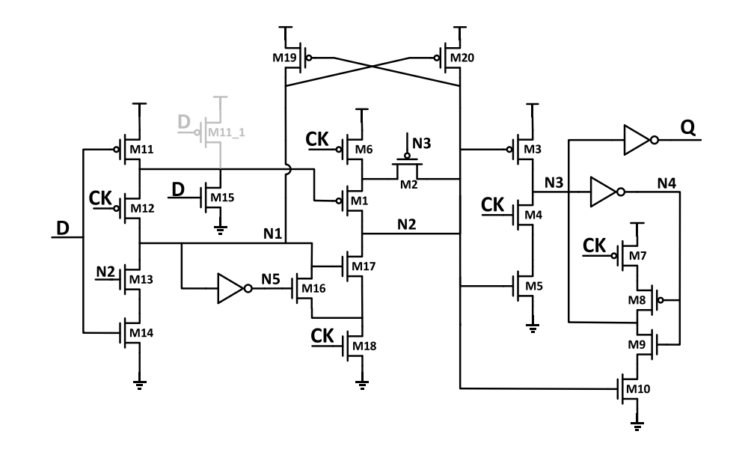
TSPC - True Single phase clocked FF
Proposed design
Features
Input aware pre-charge scheme
Floating Node Analysis
Transistor Level Optimization
Works at sub threshold voltages.

Slide 8
Input aware pre-charge scheme
The precharge operation of the node N2 in S2CFF when the input data remains 0 is unnecessary.
M1 transistor is introduced to eliminate this energy wastage.
The input of M1 is inverted D so, if D=0 no charging and if D=1 it pre-charges as usual.

Slide 9
Floating Node Analysis
Voltage of floating nodes may change after transition due to the leakage current
Using eliminated redundant charging of N2 but at Neg half cycle N2 is floating when D=0.
When Q=1 M3 should be off and M10 on to keep N3 0 so, N2 should be high
M2 is added to keep N2 high which is controlled by N3.

Slide 10
Transistor Level Optimization
S2CFF
Proposed

Slide 11
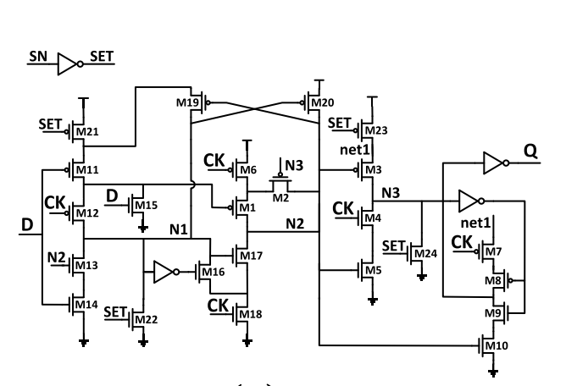
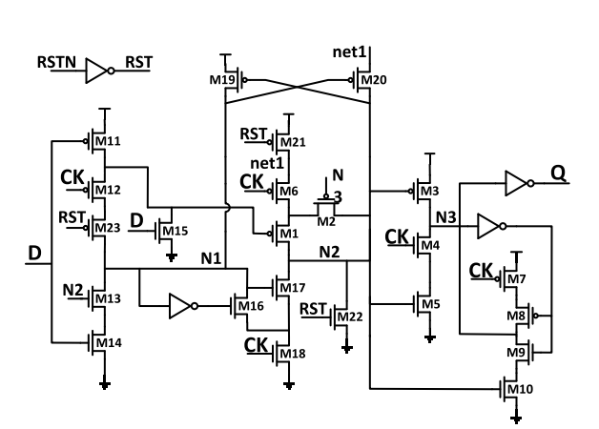
Other functionalities
Set
Reset

Slide 12
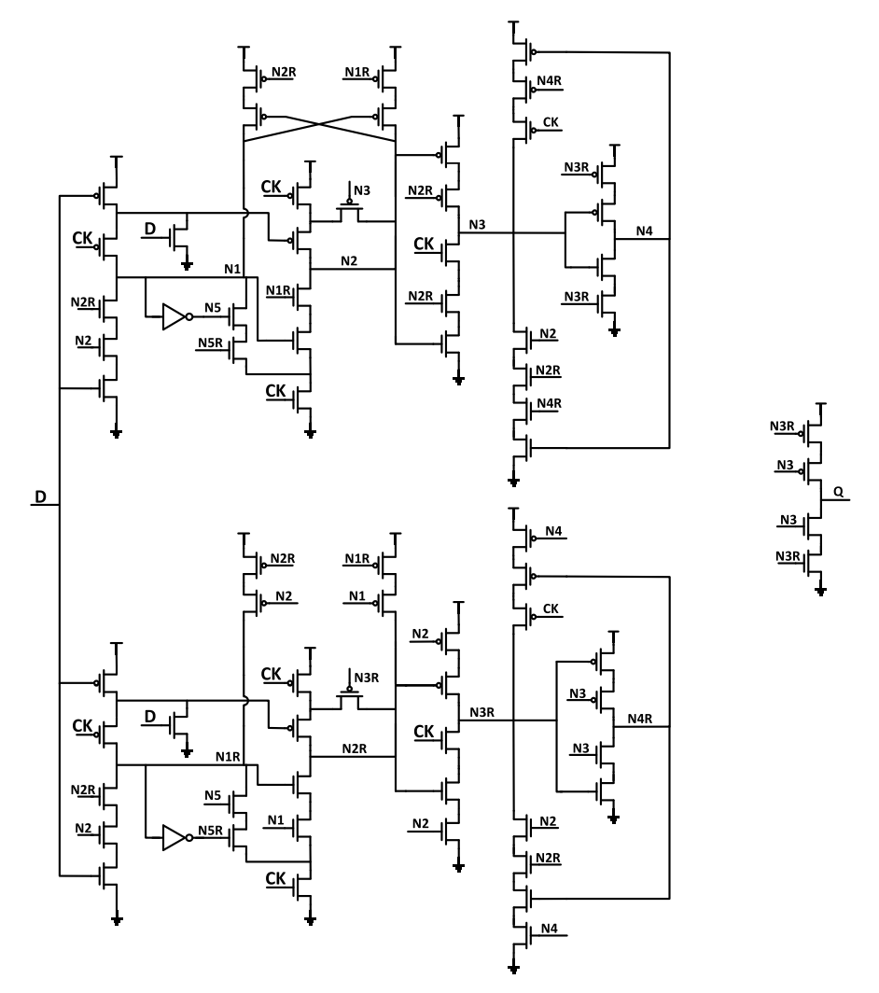
Other functionalities
SEU tolerant design

Slide 13
IMPLEMENTATION
Schematics
Simulation results
PSO

Slide 14
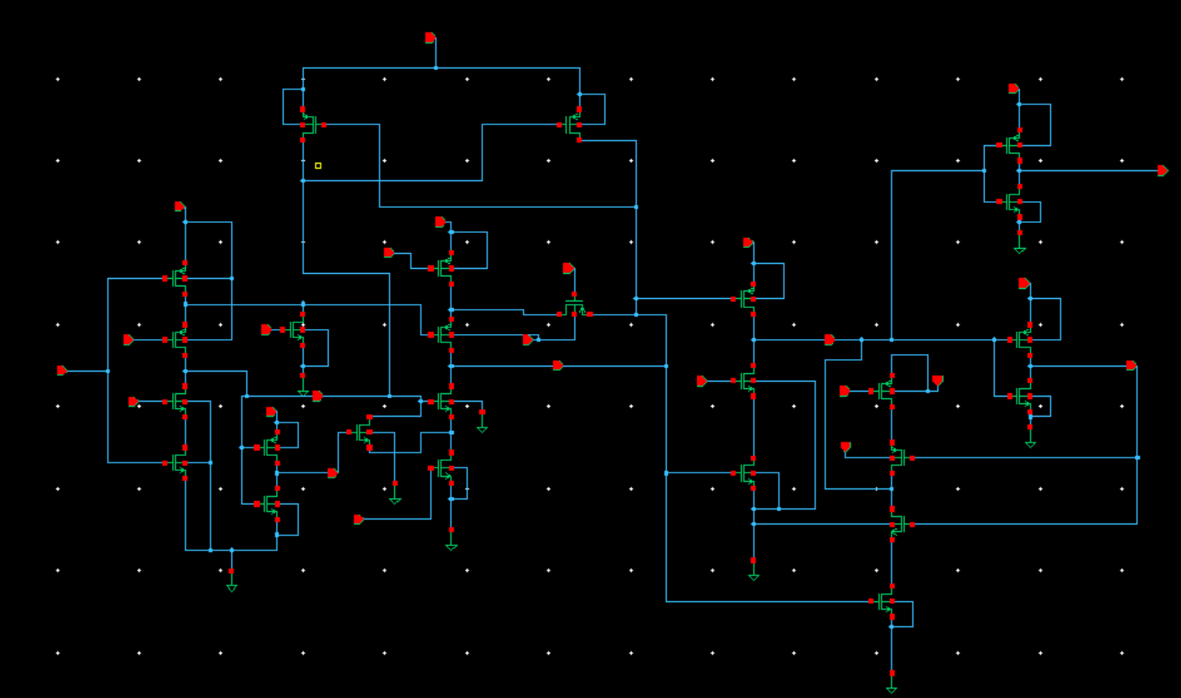
PROPOSED-schematic

Slide 15
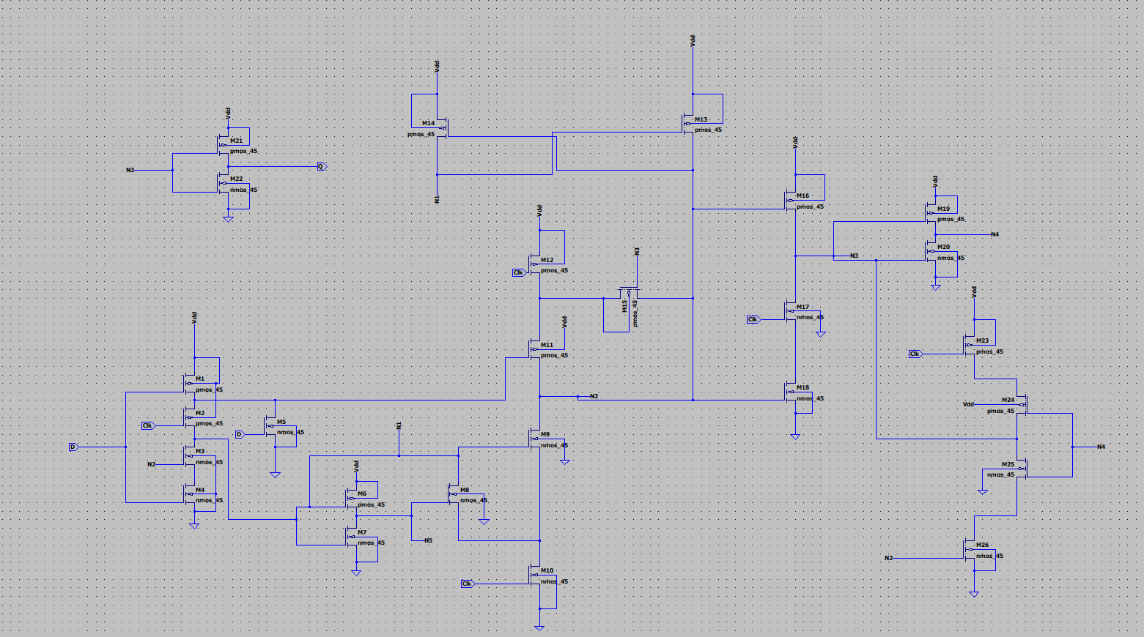
PROPOSED-schematic

Slide 16
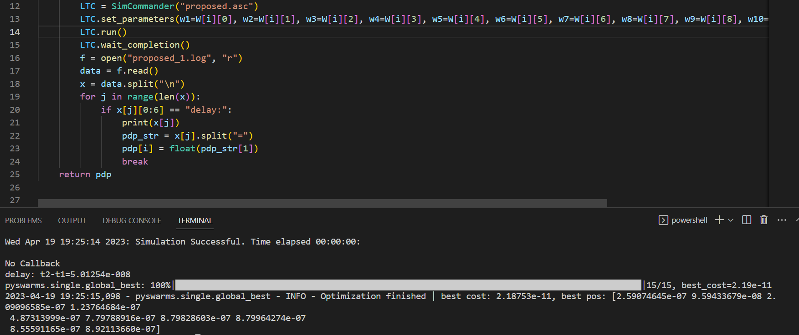
PROPOSED -PSO

Slide 17
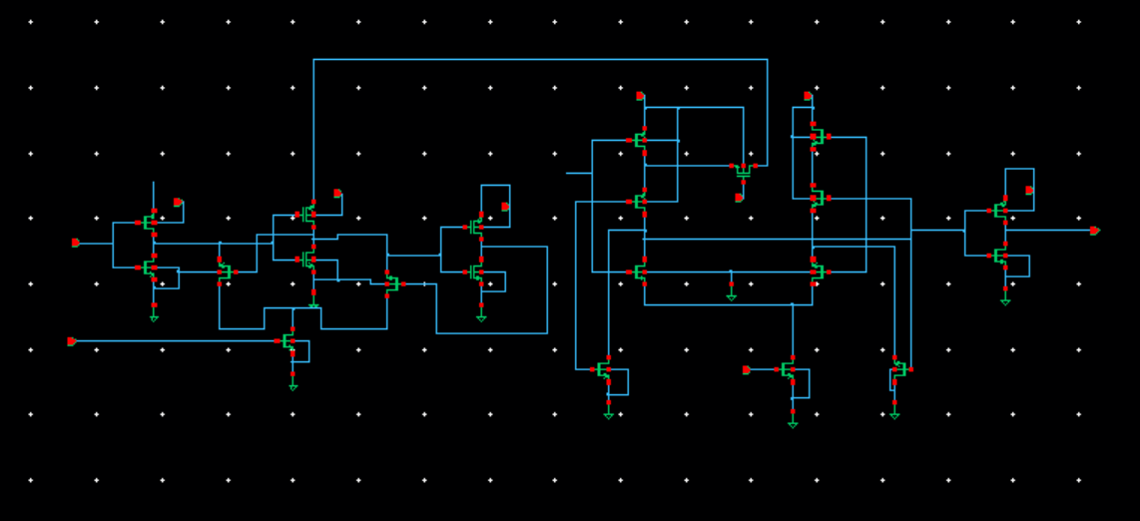
TCFF - schematic

Slide 18
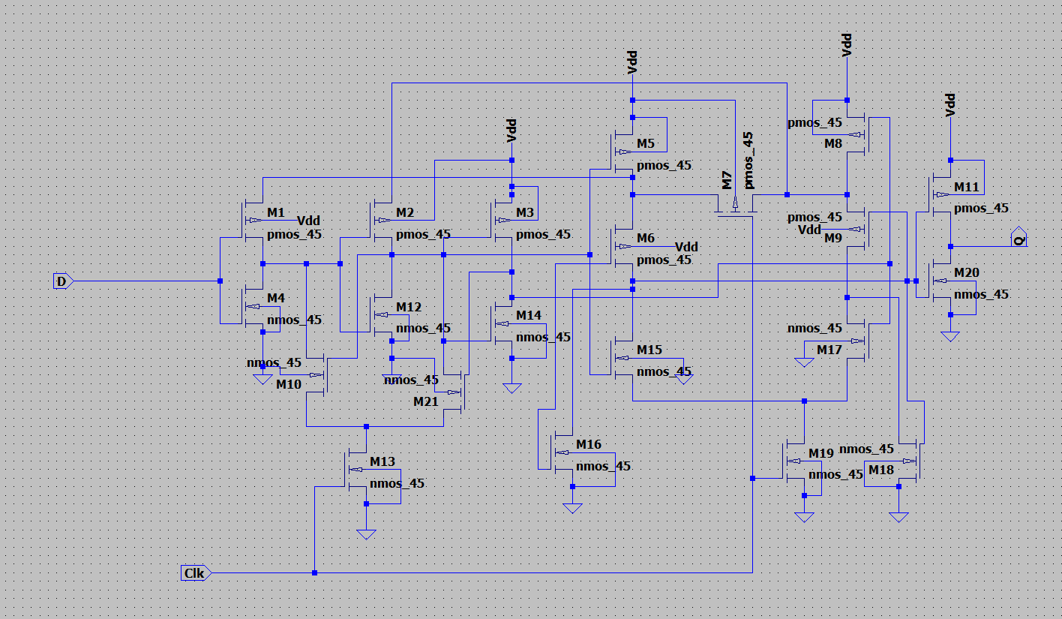
TCFF - schematic

Slide 19
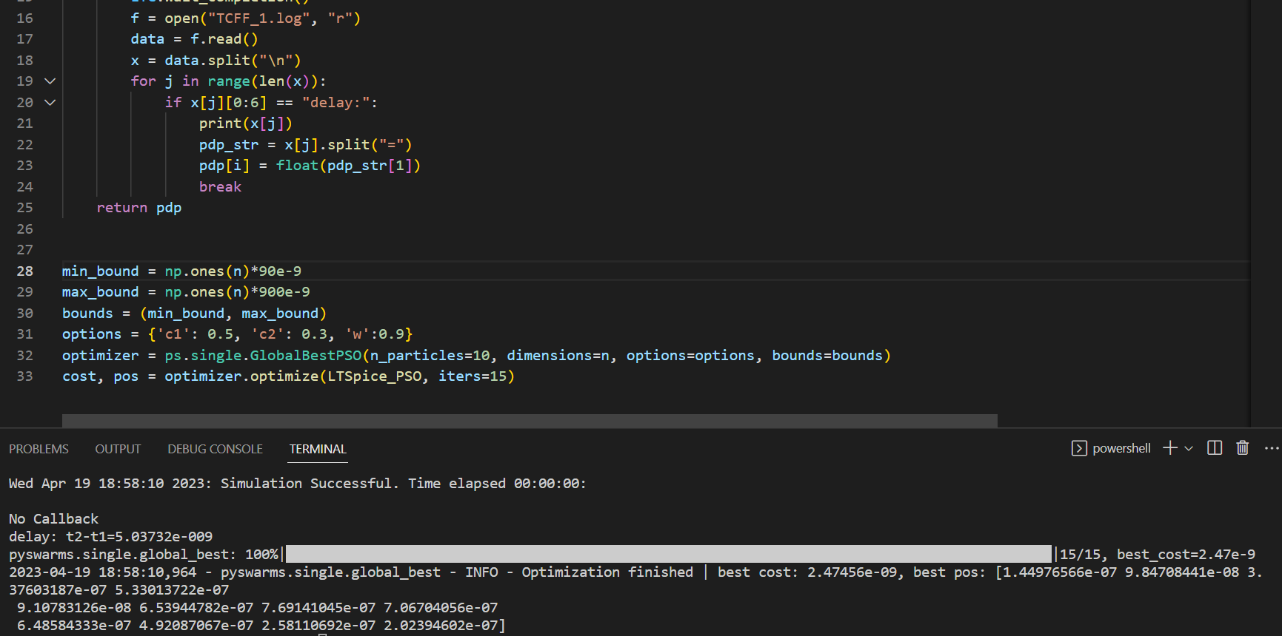
TCFF -PSO

Slide 20
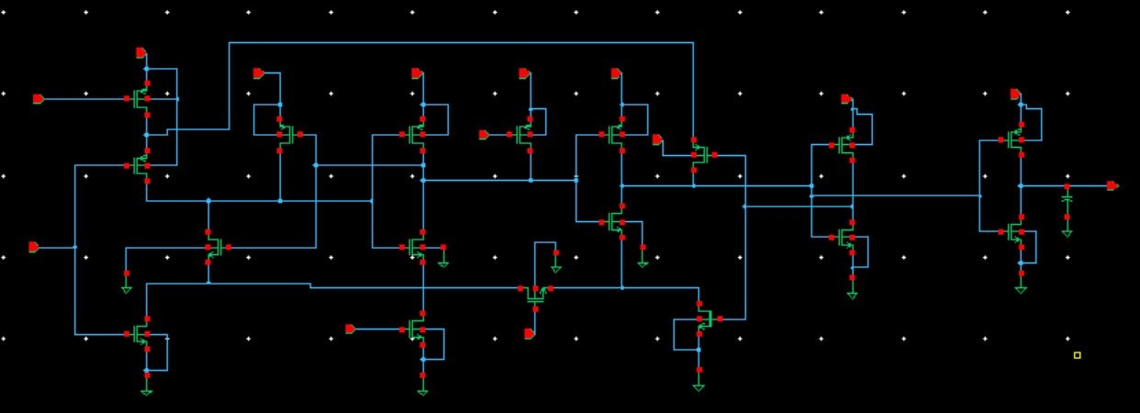
SPC-18T - schematic

Slide 21
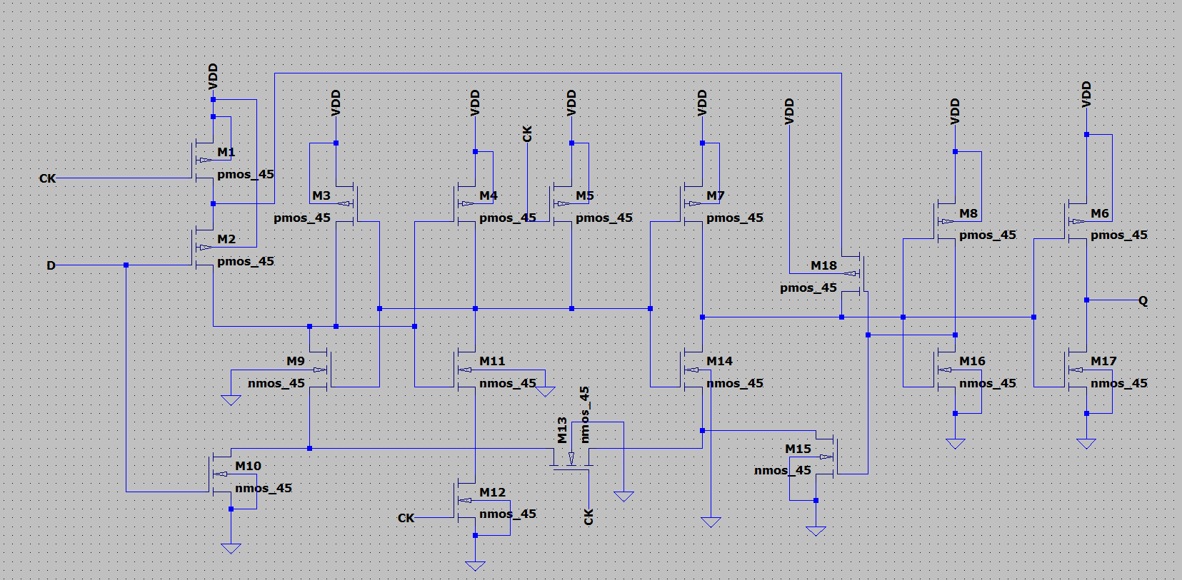
SPC-18T - schematic

Slide 22
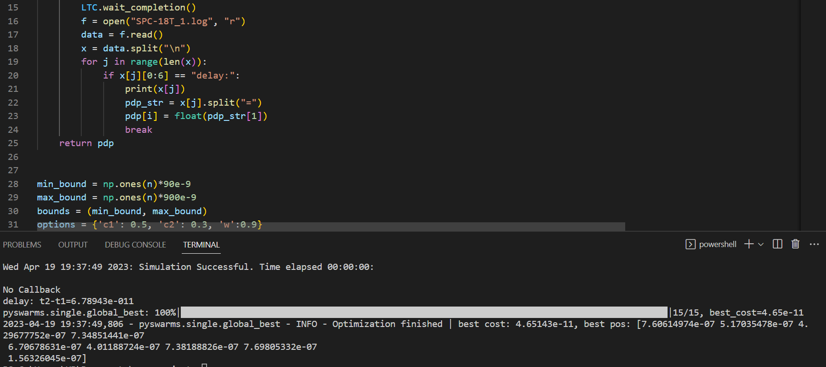
SPC-18T-PSO

Slide 23
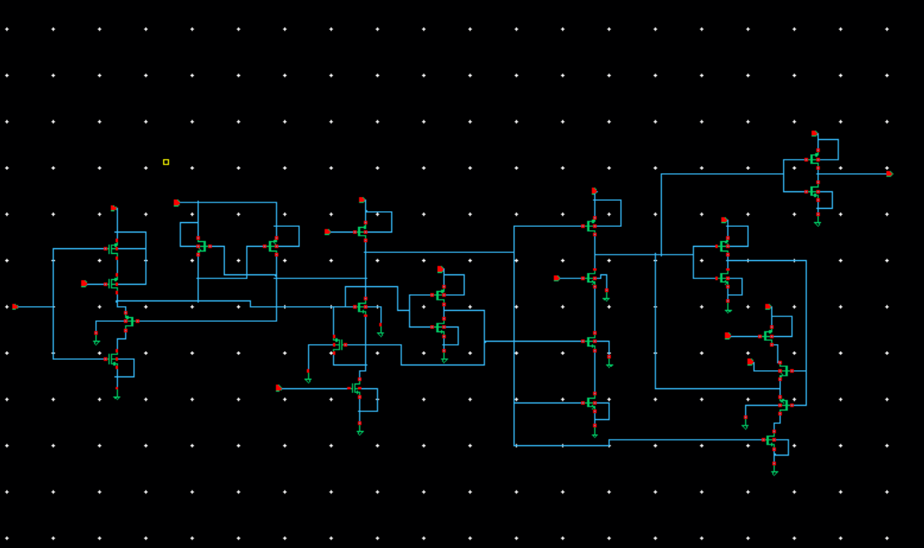
S2CFF - schematic

Slide 24
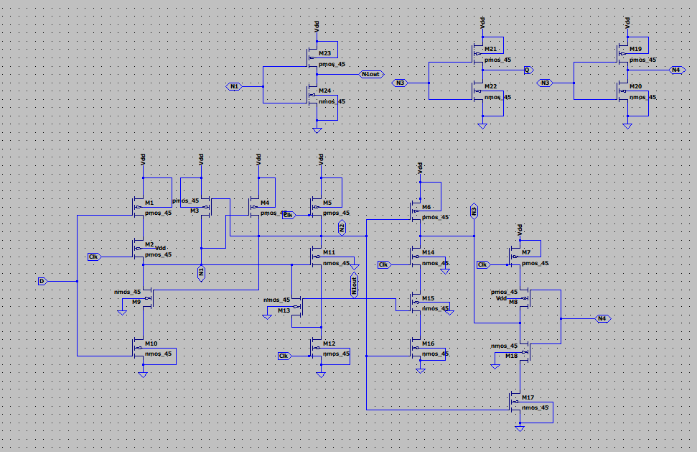
S2CFF - schematic

Slide 25
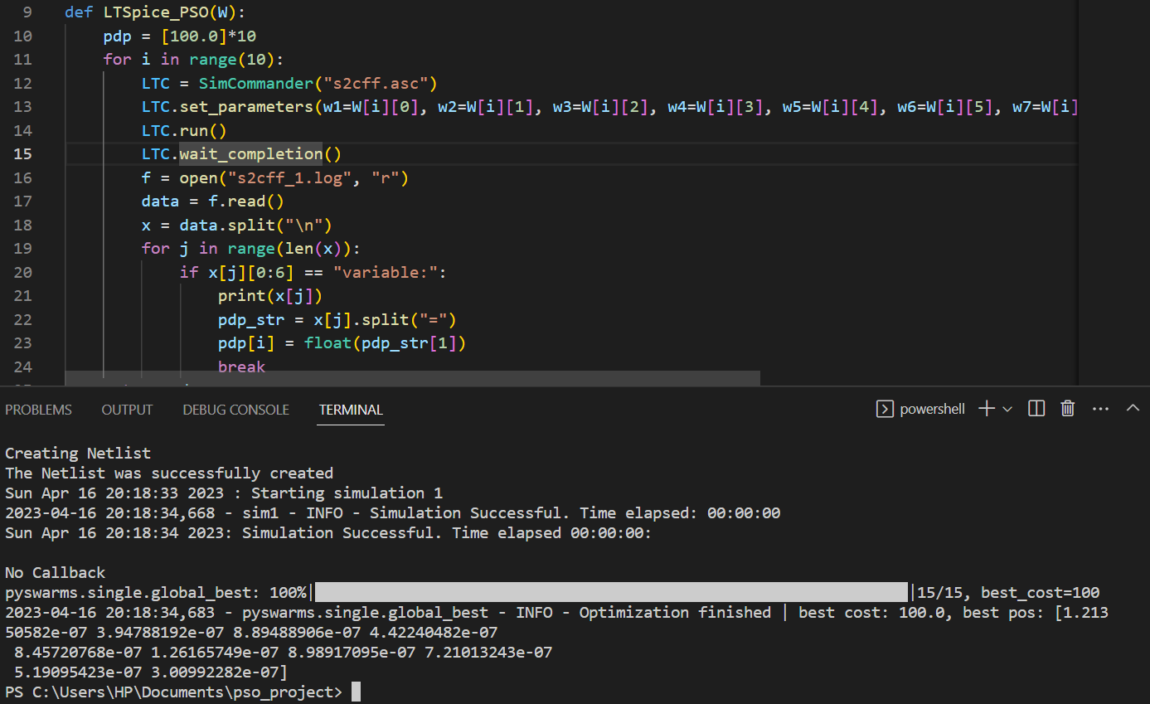
S2CFF-PSO

Slide 26
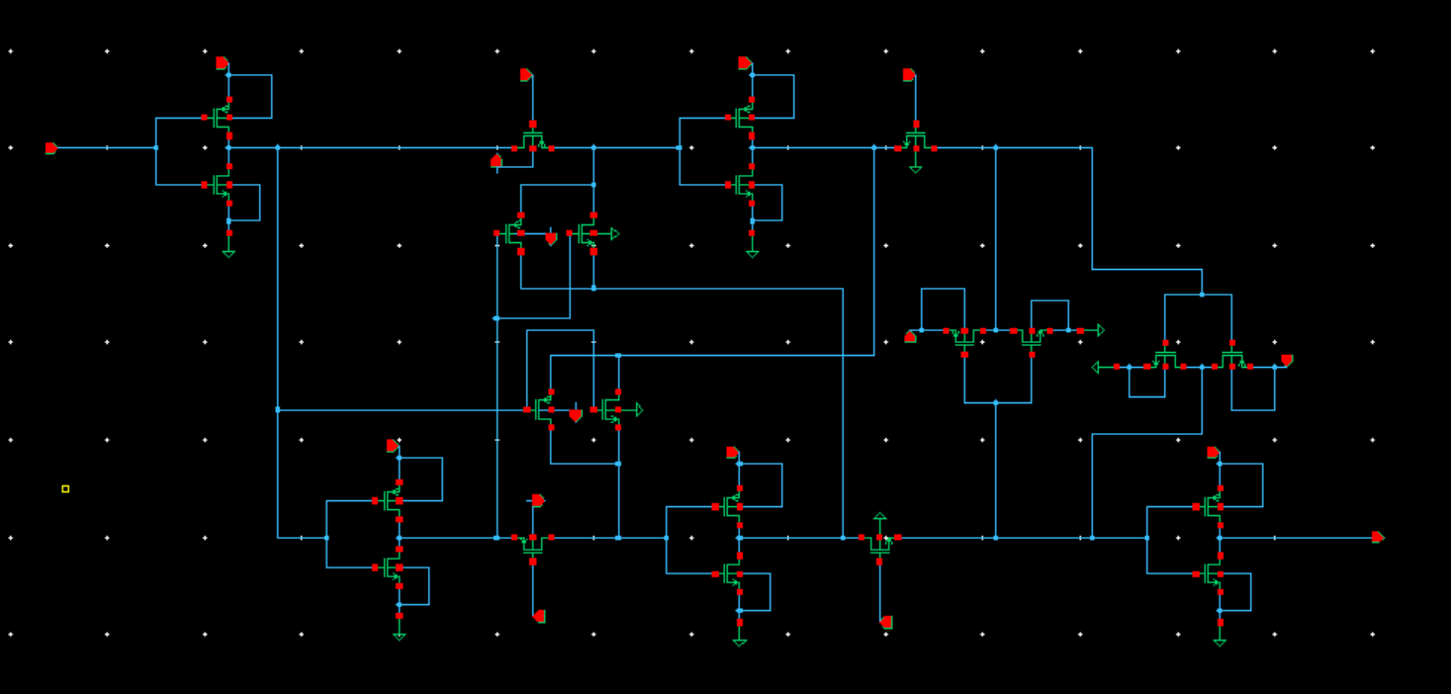
ACFF - schematic

Slide 27
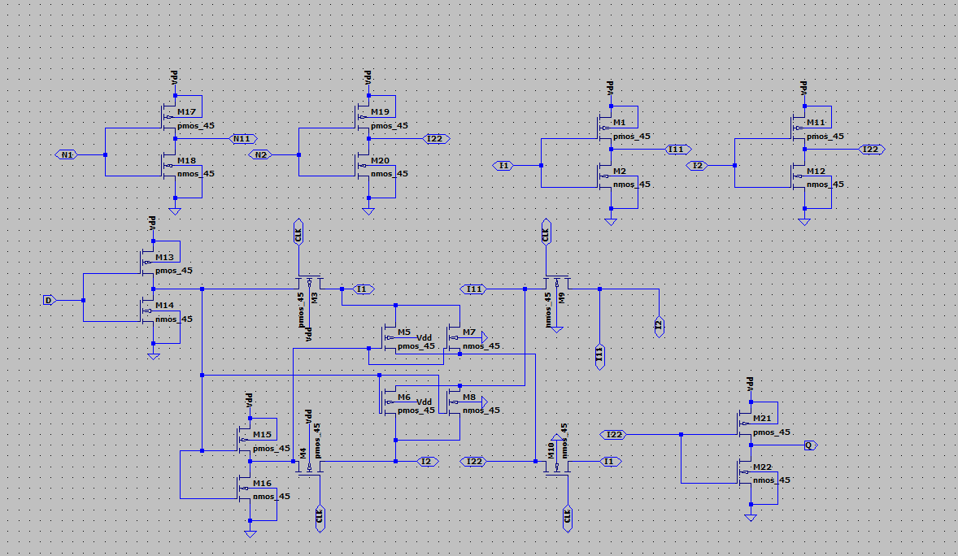
ACFF - schematic

Slide 28
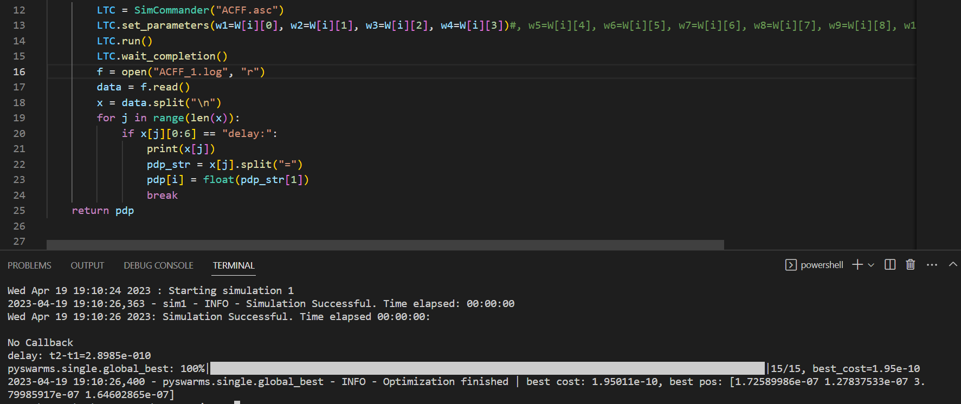
ACFF-PSO

Slide 29
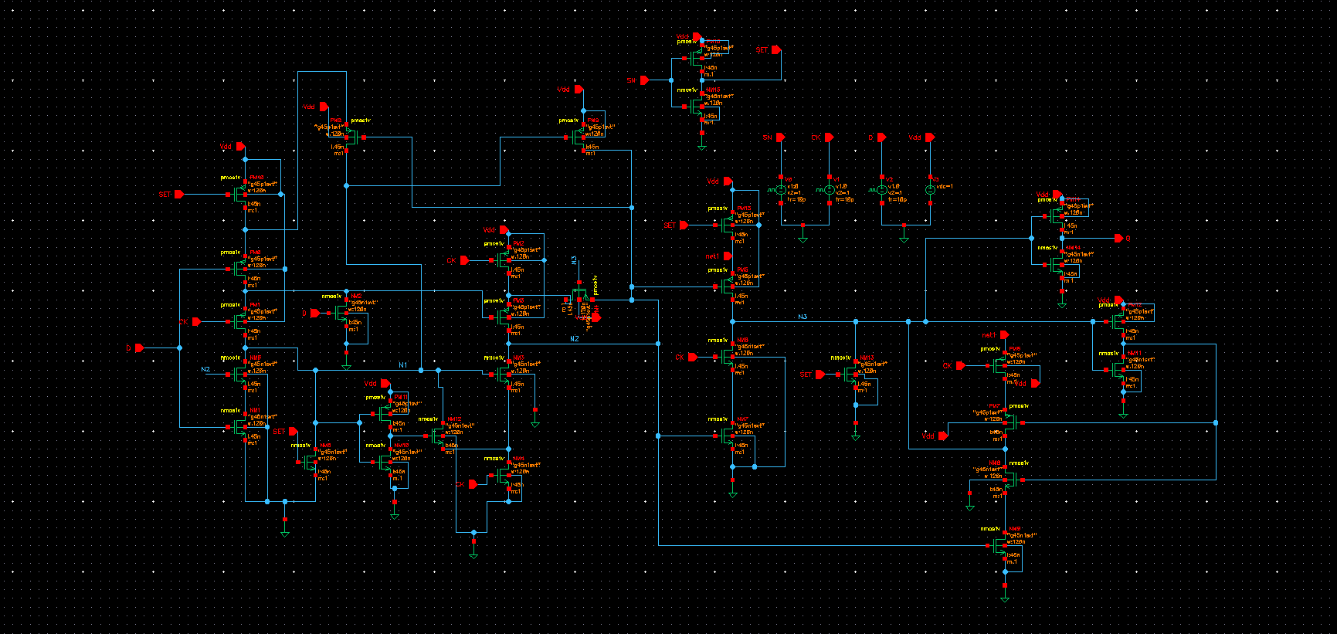
SET - schematic

Slide 30
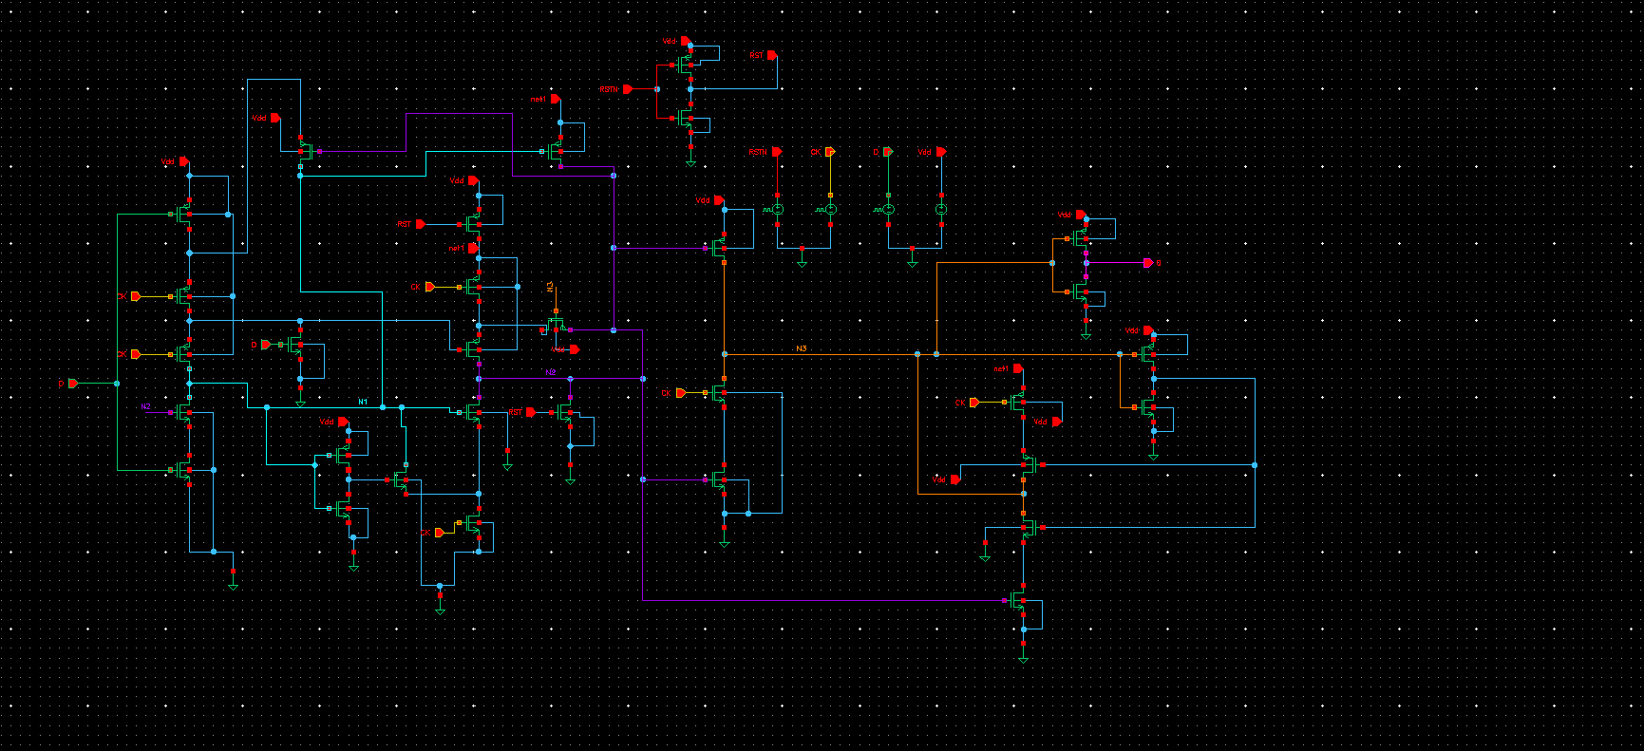
RESET - schematic

Slide 31
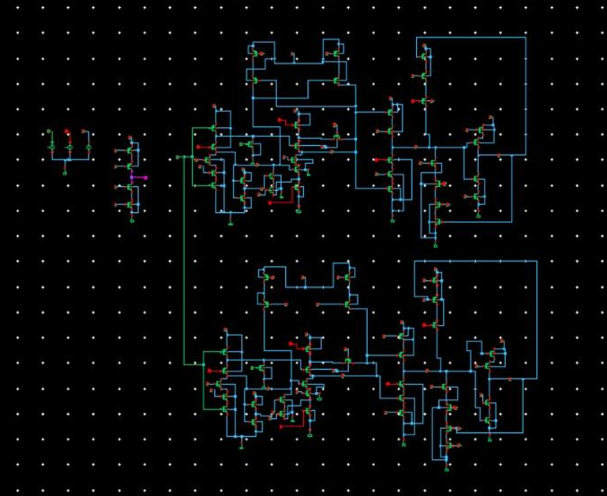
SEU - schematic

Slide 32
Results
Supply voltage vs Power
Data activity vs Power
Supply voltage vs Setup time
Supply voltage vs Hold time

Slide 33
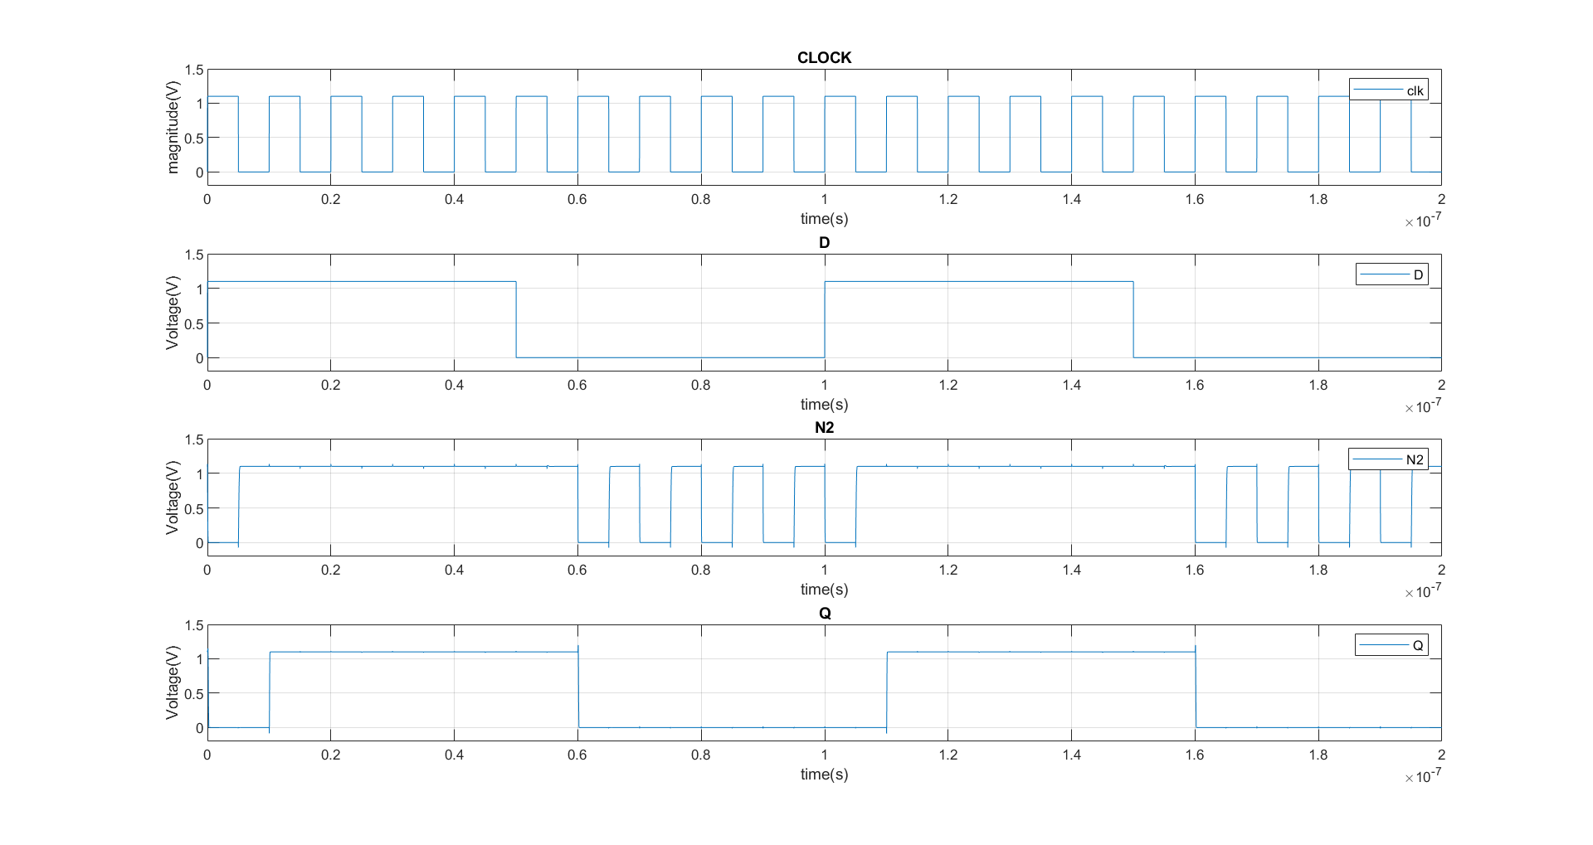
Simulation of S2CFF

Slide 34
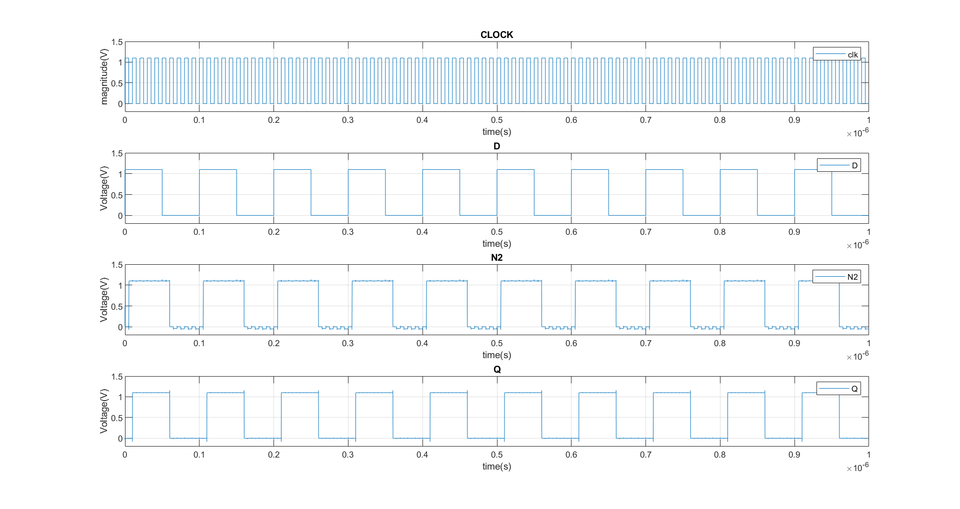
Simulation of Proposed

Slide 35
Supply voltage vs Normalised Power
Power in nW
Supply voltage (V) | SPC-18T | TGFF | Proposed | s2cff
0.6 | 96 | 140 | 66 | 114
0.7 | 149 | 208 | 108 | 177
0.8 | 200 | 282 | 151 | 253
0.9 | 266 | 348 | 197 | 328
1 | 336 | 458 | 253 | 418
1.1 | 396 | 540 | 314 | 509
Data activity = 10% and clk at 100MHz

Slide 36
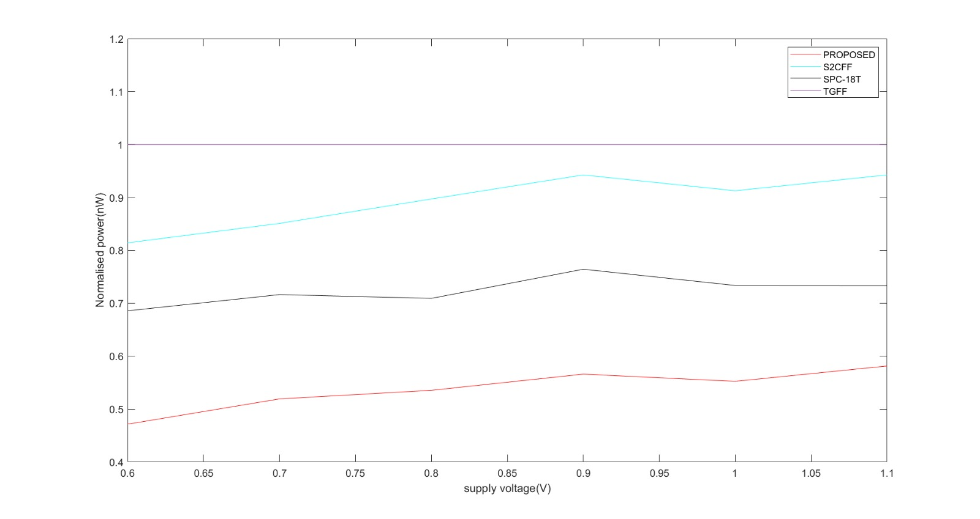
Supply voltage vs Normalised Power

Slide 37
Data activity vs Normalised Power
Power in nW
Data activity (%) | SPC-18T | TGFF | Proposed | s2cff
0 | 120 | 397 | 30 | 148
10 | 396 | 540 | 314 | 409
20 | 605 | 648 | 613 | 632
50 | 907 | 1162 | 1072 | 1078
Supply voltage = 1.1V and clk at 100MHz

Slide 38
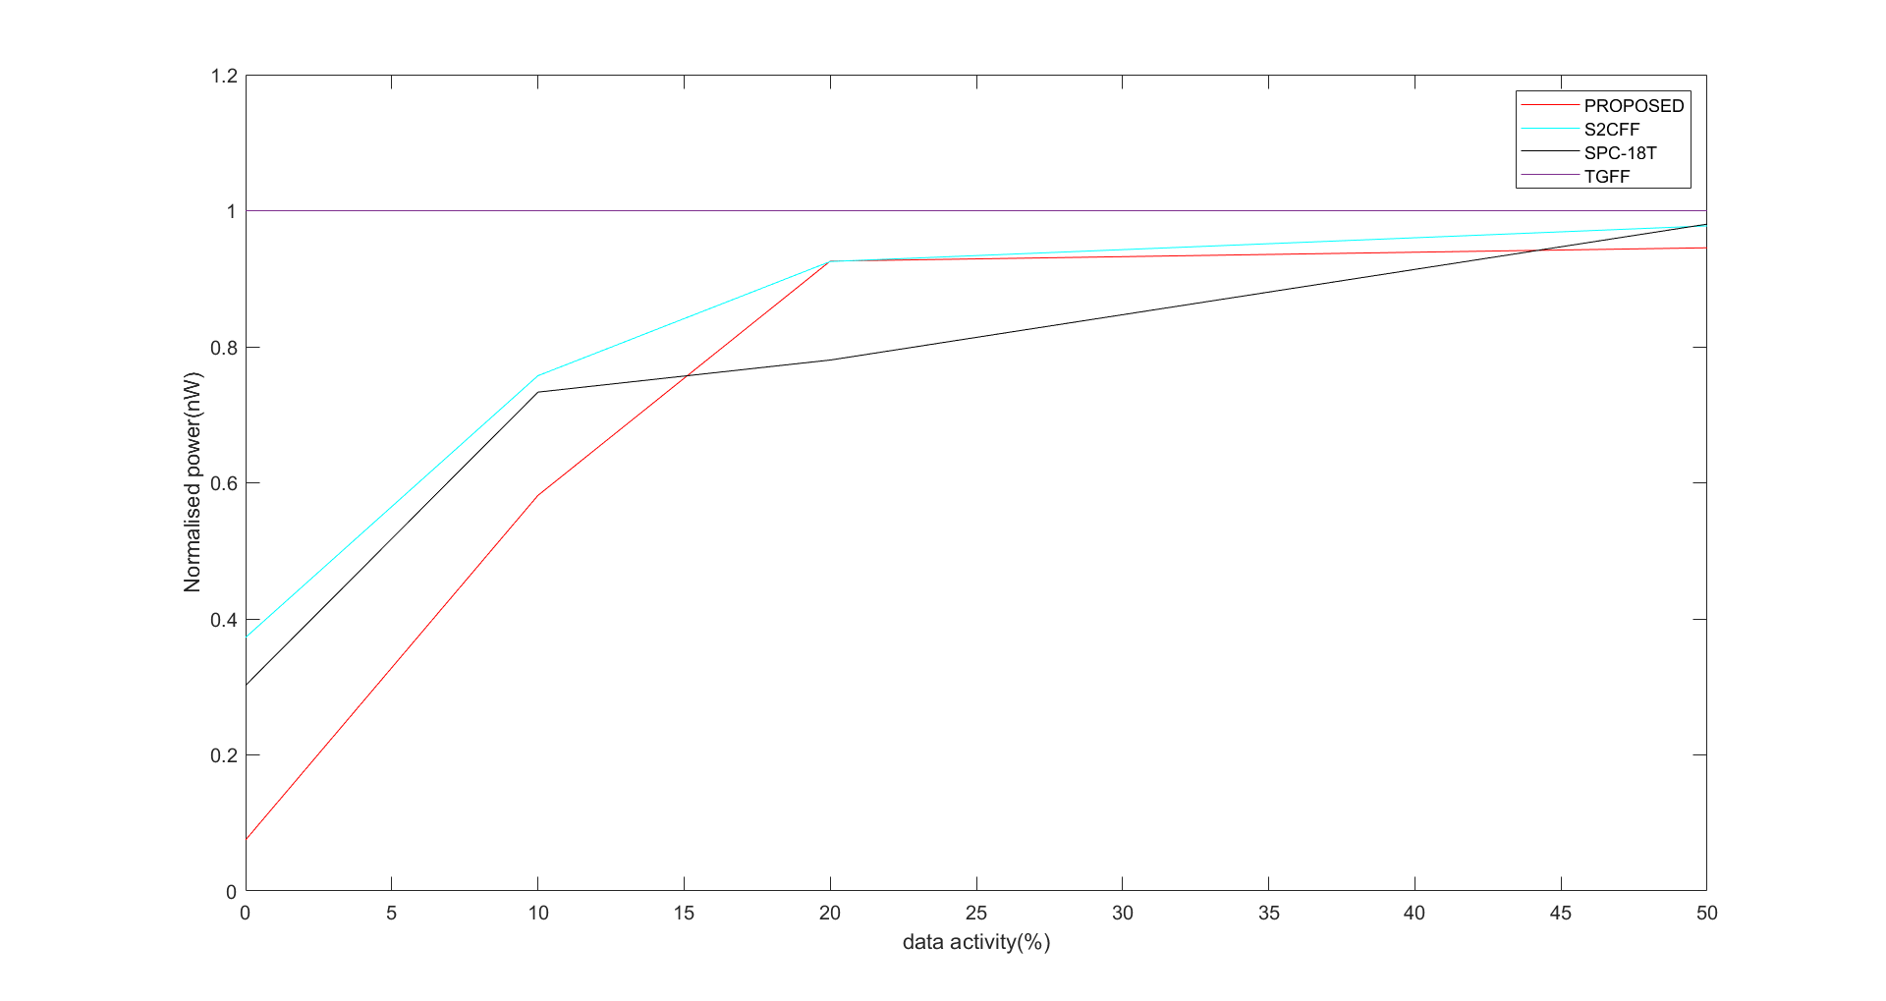
Data activity vs Normalised Power

Slide 39
Results
Parameter | TGFF | SPC-18T | s2cff | Proposed
Clock to q (ps) | 118.2 | 48.5 | 49 | 32
Power nW | 540 | 396 | 509 | 314
PDP fJ | 0.06 | 0.019 | 0.02 | 0.01
Data activity = 10%
Clk at 100MHz
Supply Voltage = 1.1V

Slide 40
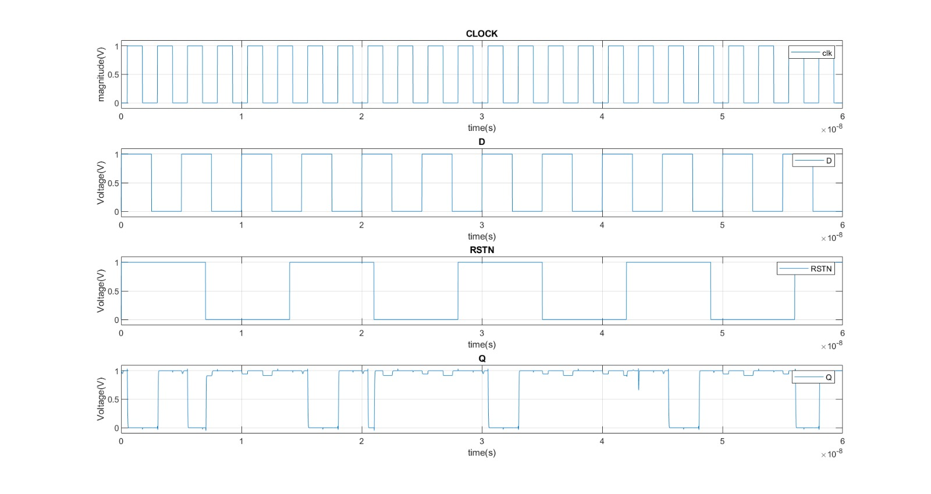
Simulation of Proposed design with Reset

Slide 41
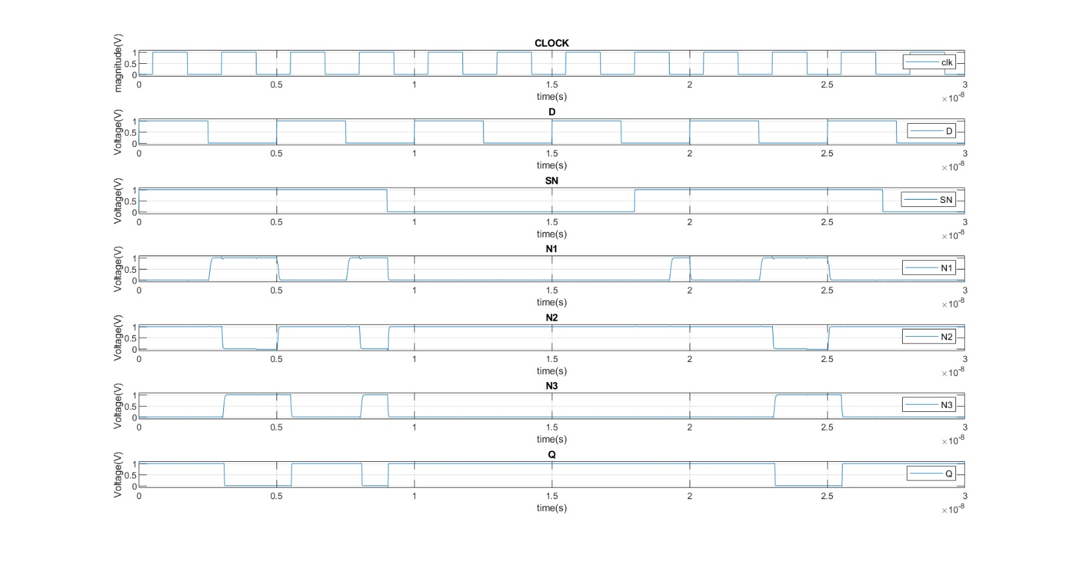
Simulation of proposed design with set signal

Slide 42
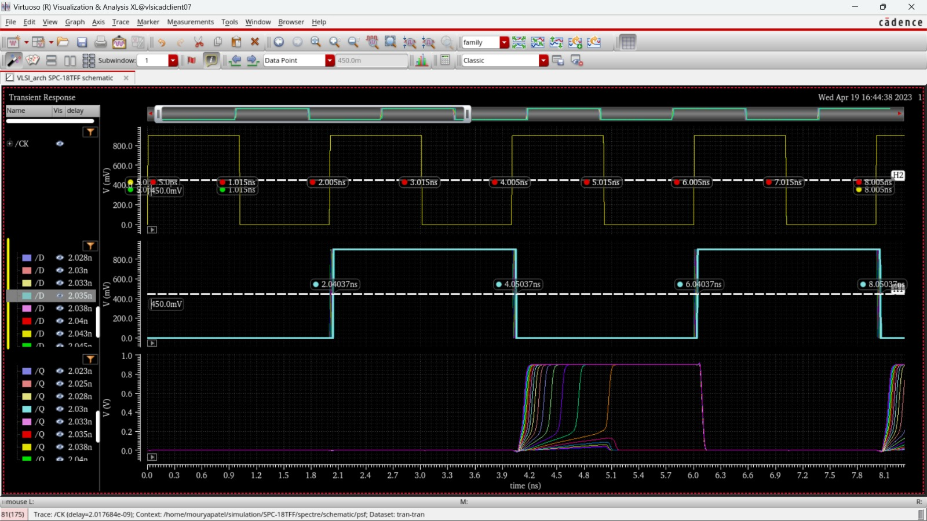
Simulation for calculating setup and hold time

Slide 43
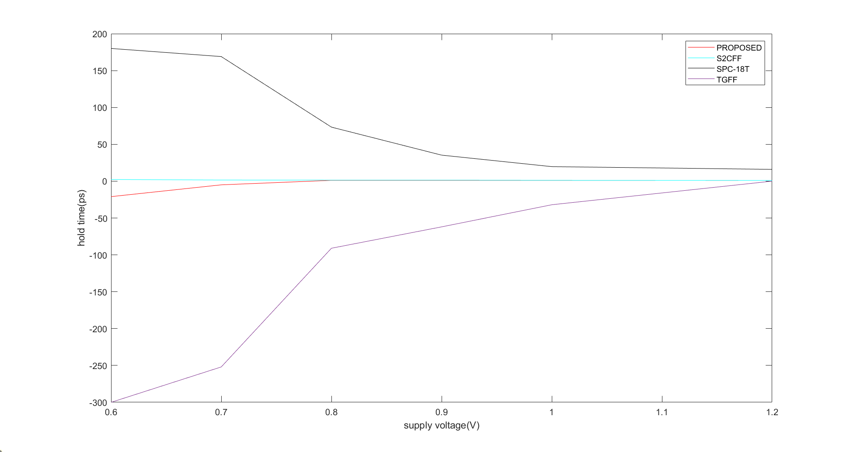
Supply voltage vs Hold time

Slide 44
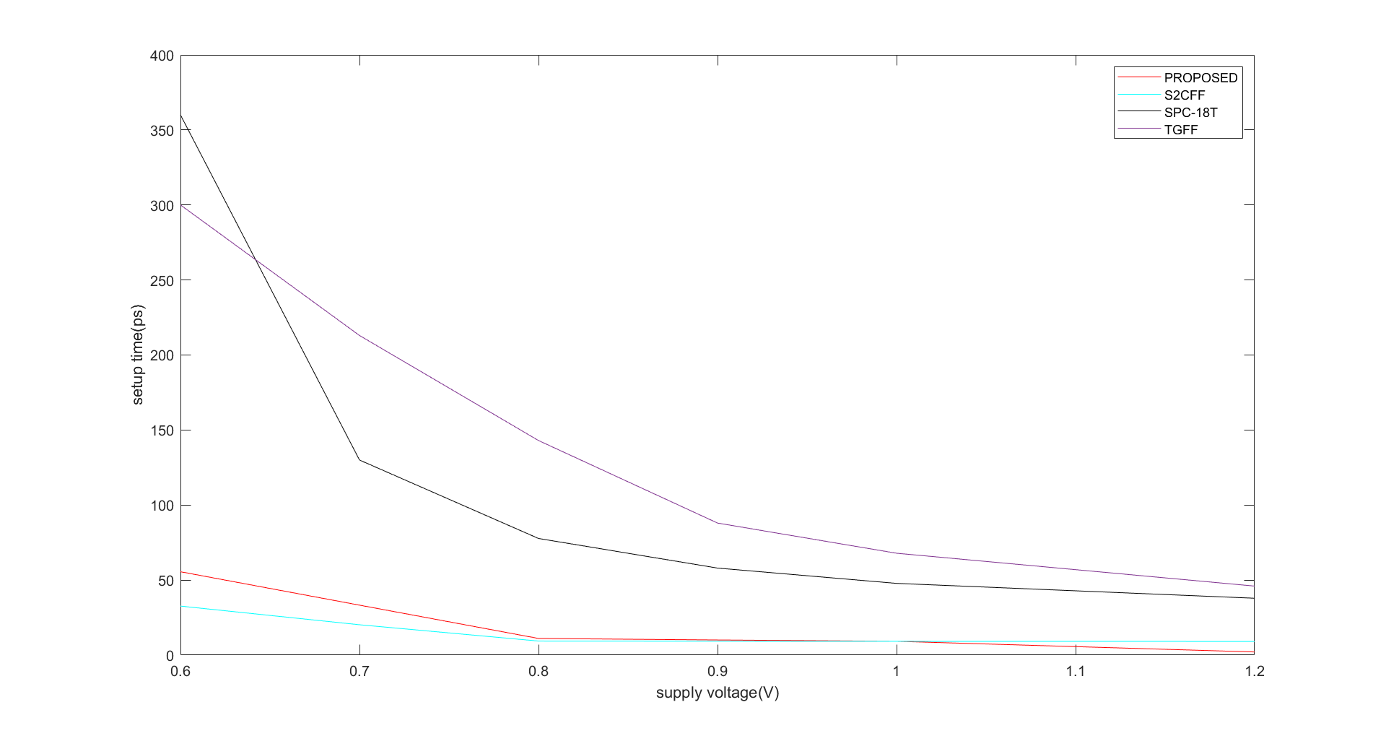
Supply voltage vs Setup time

Slide 45

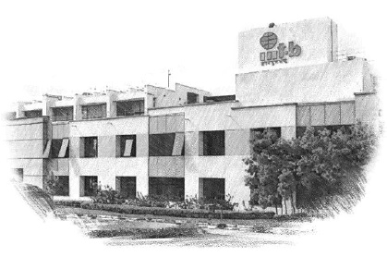






International Institute of Information Technology Bangalore
26/C, Electronics City, Hosur Road,
Bengaluru – 560 100, Karnataka, India
www.iiitb.ac.in
https://www.facebook.com/IIITBofficial/
https://twitter.com/IIITB_official
https://www.linkedin.com/school/iiit-bangalore/
https://www.youtube.com/user/iiitbmedia
https://www.instagram.com/iiitb_official/

